Slide 1

Smart Sensor
Md. Sazzadur Rahman
Assistant Professor
Jahangirnagar University,
Savar, Dhaka-1342.

Slide 2
CONTENTS
Introduction
Definition
Usefulness of silicon technology in Smart Sensor
General Architecture of Smart Sensor
Block diagram of Smart Sensor
Importance and Adoption of Smart Sensor
Consideration for Smart Sensor
Summary of Different Smart Sensor
Conclusions
Notes:
2
2

Slide 3
INTRODUCTION
Main aim of Integrating the electronics and the Sensor is to make an intelligent sensor.
Smart Sensor have the ability to take decision.
Complete system is called a system on Chip.
Smart Sensor consist of Transduction Element, Signal Conditioning Electronic and controller/processor.
Notes:
3
3

Slide 4
DEFINITION
Smart Sensors are sensors with Integrated Electronics that can perform the following functions :
a) Logic Function
b) Two way communication
c) Make Decisions
Notes:
4
4

Slide 5
USEFULNESS OF SILICON TECHNOLOGY IN SMART SENSOR
A smart sensor is made with same technology as Integrated circuits.
A transduction element either includes thin metal films, Zinc Oxide and Polymeric films.
A smart sensor utilizes the transduction properties of one class of materials and electronic properties of silicon.
Integrating electronics circuits on the sensor chip makes it possible to have single chip Solution.
Integrated sensors provide significant advantages in terms of overall size and the ability to use small signals from the transduction element.
Notes:
5
5

Slide 6
ARCHITECTURE OF SMART SENSOR
A general Architecture of smart sensor consist of following important components :
Sensing element/transduction element
Amplifier
Sample and hold
Analog multiplexer
Analog to digital converter (ADC)
Offset and temperature compensation
Digital to analog converter (DAC)
Memory
8 bit serial communication and processor
Notes:
6
6

Slide 7
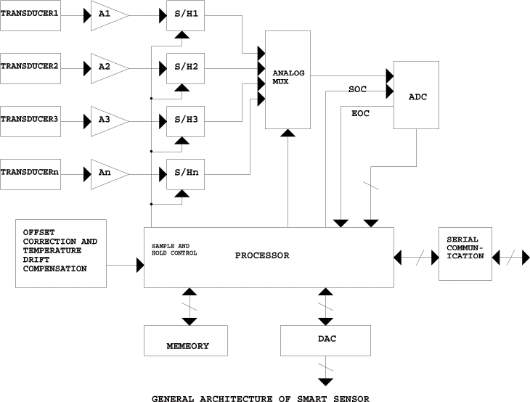
BLOCK DIAGRAM OF SMART SENSOR
Notes:
7
7

Slide 8
DESCRIPTION OF ARCHITECTURE
Architecture of smart sensor is shown. In the architecture shown A1, A2...An and S/H1, S/H2...S/Hn are the amplifiers and sample and hold circuit corresponding to different sensing element respectively.
So as to get a digital form of an analog signal the analog signal is periodically sampled (its instantaneous value is acquired by circuit), and that constant value is held and is converted into a digital words.
Any type of ADC must contain or proceeded by, a circuit that holds the voltage at the input to the ADC converter constant during the entire conversion time.
ADC starts conversion when it receives start of conversion signal (SOC) from the processor and after conversion is over it gives end of conversion signal to the processor.

Slide 9
To be continue...
Outputs of all the sample and hold circuits are multiplexed together so that we can use a single ADC, which will reduce the cost of the chip.
Offset compensation and correction comprises of an ADC for measuring a reference voltage and other for the zero.
Dedicating two channels of the multiplexer and using only one ADC for whole system can avoid the addition of ADC for this.
This is helpful in offset correction and zero compensation of gain due to temperature drifts of acquisition chain.
In addition to this smart sensor also include internal memory so that we can store the data and program required.

Slide 10
SIGNAL CONVERSION EFFECTS
We know that silicon shows a suitable physical signal conversion effect. Many of the physical effects of silicon can be used in making sensors. Based on these effects, different types of sensors can be constructed which can be used for measuring different physical and chemical measured.
Table1 below shows how different non electrical signal in which we can classify different measured.
Table 1
Signal Domain Examples
Radiant Signals Light intensity,polarization,phase,wavelength
Mechanical Signals Force ,pressure,flow,vacuum,thickness
Thermal Signals Temperature , Temperature gradient,heat
Chemical Signals Concentration,pH,toxicity
Magnetic Signals Field intensity ,flux density,permeability
Notes:
10
10

Slide 11
PHYSICAL EFFECTS FOR SENSOR IN SILICON
Table 2 shows the physical effects for sensors in silicon.
Table 2
Examples
Radiant Signals Photo voltaic effect, photoelectric effect,
photo conductivity, and photo magneto-electric
effect.
Mechanical Signals piezoresistivity
Thermal Signals Seebeck effect,temperature dependence of
conductivity
Chemical Signals Ion sensitive field effect
Magnetic Signals Hall effect,magneto resistance
One problem with silicon is that its sensitivities to strain, light and magnetic field show a large cross- sensitivity to temperature. When it is not possible to have silicon with proper effect, it is possible to deposit layers of materials with desired sensitivity on the top of a silicon substrate. Thus we can have a magnetic field sensor by depositing Ni-Fe layer on the top of a silicon substrate.
Notes:
11
11

Slide 12
Different Silicon Sensors Employing Above Effects
Radiant Signal Domain
Silicon can be used to construct a sensor for sensing wide range of radiant signal from gamma rays to infrared.
Silicon can be used for the fabrication of photo conductors, photo-diode, and photo-transistor or to detect nuclear radiation.

Slide 13
MECHANICAL SIGNAL DOMAIN
Silicon Can be used for measuring force & pressure because of piezo-electrics effect.
By heating a silicon structure having two temperature devices and is brought to air flow then resulting the temperature difference is proportional to square root of flow velocity
Notes:
13
13

Slide 14
THERMAL SIGNAL DOMAIN
Electron devices in Silicon show temperature dependence this property of Silicon can be used for the measurement of Temperature
We can measure temperature because see back in Silicon is very large
Magnetic Signal Domain
It can be used for the Construction of Hall Plates & Transistor structure that are sensitive to magnetic field
It can be used as humidity sensor or gas sensor.
Chemical Signal Domain
Notes:
14
14

Slide 15
IMPORTANCE & ADOPTION OF SMART SENSOR
REDUCE COST OF BULK CABLES & CONNECTORS
By using smart sensor the cost of bulk cables and connectors is reduced.
.
REMOTE DIAGNOSTIC
It is possible to have digital communication via a standard bus & a built in self-test.
Cost improvement
In case of smart sensor inside hardware is more complex in the
sensor on the other hand it is simpler outside the sensor. Thus
the cost of the sensor is in its setup, which can be reduced by
reducing the effort of setup, and by removing repetitive testing.
Notes:
15
15

Slide 16
IMORTANCE & ADOPTION OF SMART SENSOR
System Reliability
System reliability is significantly improved due to the utilization of smart sensor.
Better signal to Noise ratio
The electrical output of most sensors is very weak and it is transmitted through long wires lot of noise get coupled by using smart sensor this problem is avoided.

Slide 17
ENHANCEMENT OF APPLICATION
Self Calibration :It means adjusting some parameters of sensor during fabrication this can be either gain or offset or both.
Computation : Computation is also allows one to obtain the average, variance and standard deviation for the set of measurements.
Communication : Communication is the means of exchanging or conveying information.
Multi sensing : Some smart sensor has to measure more than one physical or chemical variable simultaneously

Slide 18
FUNCTIONS WITHIN ELECTRONICS
Many a times it is required to alter the sensor excitation over the operating range of a SENSOR. An example of this is SILICON Wheatstone bridge, where the drive voltage is increased with increasing temperature
ANALOG INPUT
Multiplexing of inputs can be done to avoid duplication of circuits in multiplexing inputs of same type and range are switched to a common front end.
DATA CONVERSION
In case of Smart sensor most of the signal processing in digital form this is possible we have an ADC along with an Anti-aliasing filter.
Notes:
18
18

Slide 19
To be continue...
Monitoring and diagnostic functions
In many applications self-test is required. This self-test includes connectivity checking and long-term offset correction.
Digital data bus interface
The controller embedded in the smart sensor supports communications by digital data bus. The advantages of this are:
Wiring is reduced considerably
Automatic calibration at production can be simplified.
Control processor
To provide greater flexibility and reduced complexity, a control processor can be used. Control processor can do digital filtering. Another important point is software development. Processor must allow writing codes in higher language as it reduces the development time.

Slide 20
IMPROVEMENT IN CHARACTERISTICS
Non-linearity: Many of the sensors show some non-linearity, by using on-chip feedback systems or look- up tables we can improve linearity.
Cross-sensitivity: Most of the sensors show an undesirable sensitivity to strain and temperature. Incorporating relevant sensing elements and circuits on the same chip can reduce the cross-sensitivity.
Offset: Offset adjustment requires expensive trimming procedures and even this offsets tend to drift. This is very well reduced by sensitivity reduction method.
Parameter drift and component values: These are functions of time. This can be solved by automatic calibration.

Slide 21
SUMMARY OF DIFFERENT SMART SENSOR
OPTICAL SENSORS
It is used for measuring exposure in cameras, optical angle encoders
ACCELEROMETER
It consists of sensing element and electronics on SILICON
INTREGATED MULTI SENSOR
This chip was fabricated using conventional Silicon planer processing, Silicon Micro machining and thin deposition technique.
INFRARED DETECTOR ARRAY
The infrared-sensing element was developed using polysilicon -Au thermocouples & thin film dielectric diaphragm to support the thermocouples.
Notes:
21
21

Slide 22
CONCLUSION
In conclusion, silicon is very suitable material for fabrication of smart sensors. But still a lot of research is required to get benefits of the smart sensor, but from the experience of already existing devices, we can expect that in the coming decade a large number of successful smart sensors will emerge.
Notes:
22
22

Slide 23
THANK YOU FOR YOUR
CO-OPERATION

